Slide 1
My people

Slide 2
[People map - who & why]

Slide 3
PEOPLE AS POETRY
Notes:
CONNECTION
Connections, relationships & humanity.
Refer Sawubona, tribes and communities

Slide 4
We are all connected
“When we interact with others through a lens of loving-kindness, it’s infinitely easier to understand that we are all interconnected. “The more we pay attention,” Sharon says, “the more we realize that we live in an interconnected world.”
Notes:
https://www.forbes.com/sites/robdube/2021/04/13/4-ways-sharon-salzberg-says-loving-kindness-can-change-your-life/?sh=29e8b3776698

Slide 5
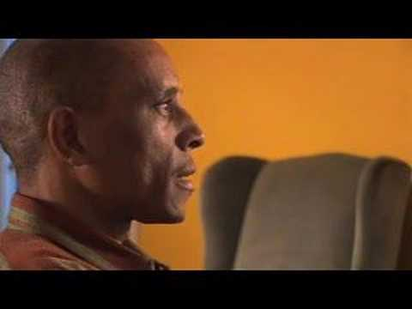
Notes:
Question: how do I have to be in order for you to be free?

Slide 6
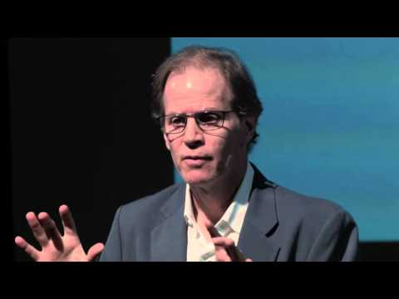
From me to we

